Slide 1
Modern Agriculture: Its Effects on the Environment

Slide 2
Introduction
Agricultural scientists have arrived at a general consensus that modern agriculture confronts an environmental crisis. A growing number of people have become concerned about the long-term sustainability of existing food production systems.
Evidence shows that the present capital- and technology-intensive farming systems have been extremely productive and competitive but they also bring a variety of economic, environmental and social problems.

Slide 3
The expansion of monocultures
Today, monocultures have increased dramatically worldwide, mainly through the geographical expansion of land devoted to single crops and year-to-year production of the same crop species on the same land.
There are political and economic forces influencing the trend to devote large areas to monoculture, and in fact such systems are rewarded by economies of scale and contribute significantly to the ability of national agricultures to serve international markets.

Slide 4
The 1st wave of environmental problems
A number of "ecological diseases" have been associated with the intensification of food production. They can be grouped into two categories: diseases of the ecotype, which include erosion, loss of soil fertility, depletion of nutrient reserves, salinization and alkalinization, pollution of water systems, loss of fertile croplands to urban development;
Diseases of the biocoenosis, which include loss of crop, wild plant, and animal genetic resources, elimination of natural enemies, pest resurgence and genetic resistance to pesticides, chemical contamination, and destruction of natural control mechanisms.
The loss of yields due to pests in many crops (reaching about 20-30% in most crops), despite the substantial increase in the use of pesticides is a symptom of the environmental crisis affecting agriculture.

Slide 5
The 1st wave of environmental problems…
The environmental (impacts on wildlife, pollinators, natural enemies, fisheries, water and development of resistance) and social costs (human poisonings and illnesses) of pesticide use reach about $8 billion each year in US only.
The fertilizer that is not recovered by the crop ends up in the environment, mostly in surface water or in groundwater.
Nitrate contamination of aquifers is widespread and in dangerously high levels in many rural regions of the world. In the US, it is estimated that more than 25% of the drinking water wells contain nitrate levels above the 45 parts per million safety standard. Such nitrate levels are hazardous to human health.

Slide 6
The 1st wave of environmental problems…..
It is clear that the first wave of environmental problems is deeply rooted in the prevalent socioeconomic system which promotes monocultures and the use of high input technologies and agricultural practices that lead to natural resource degradation.

Slide 7
The 2nd wave of environmental problems
Despite that awareness of the impacts of modern technologies on the environment increased, as we traced pesticides in food chains and crop nutrients in streams and aquifiers, there are still some argue for further intensification to meet the requirements of agricultural production.
Supporters of this concept in favour of the mass level promotion of bio-technology as the latest magic bullet that will revolutionize agriculture with products based on natures’ own methods, making farming more environmentally friendly and more profitable for the farmer.

Slide 8
The second wave of environmental problems……….
In fact, such biotechnological products will do nothing but reinforce the pesticide treadmill in agro-ecosystems, thus legitimizing the concerns that many scientists have expressed regarding the possible environmental risks of genetically engineered organisms (GMOs).
What is ironic is the fact that the bio-revolution is being brought forward by the same interests (Monsanto, Novartis, DuPont, etc.) that promoted the first wave of agro-chemically-based agriculture.

Slide 9
Major environmental risks associated with genetically modified/engineered (GM) crops
Corporations want to promote a single product internationally, thus creating the conditions for genetic uniformity in rural landscapes. However, history has repeatedly shown that a huge area planted to a single cultivar is vulnerable to a new types of pathogen or pest.
The spread of transgenic crops threatens crop genetic diversity by simplifying cropping systems and promoting genetic erosion.
The transfer of genes from herbicide resistant crops (HRCs) to wild or semi-domesticated relatives can lead to the creation of super weeds.
Notes:
A transgenic crop plant contains a gene or genes which have been artificially inserted instead of the plant acquiring them through pollination. The inserted gene sequence (known as the transgene) may come from another unrelated plant, or from a completely different species: transgenic Bt corn, for example, which produces its own insecticide, contains a gene from a bacterium. Plants containing transgenes are often called genetically modified or GM crops, although in reality all crops have been genetically modified from their original wild state by domestication, selection and controlled breeding over long periods of time.

Slide 10
Major environmental risks associated with genetically modified/engineered crops…
It is expected that biotechnology will exacerbate the problems of conventional agriculture and by promoting monocultures, which will also undermine ecological methods of farming such as rotations and polycultures.

Slide 11
Soil Erosion
Soil erosion is one form of soil degradation and it is a naturally occurring process on all land. The agents of soil erosion are water and wind, each contributing a significant amount of soil loss each year.
Soil erosion may be a slow process that continues relatively unnoticed, or it may occur at an alarming rate causing serious loss of topsoil. The loss of soil from farmland may be reflected in reduced crop production potential, lower surface water quality and damaged drainage networks.
Soil erosion potential is increased if the soil has no or very little vegetative cover of plants and/or crop residues.

Slide 12
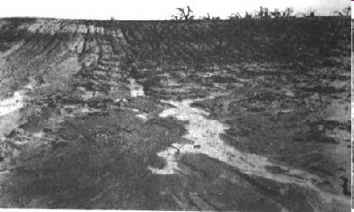
Soil erosion

Slide 13
Conservation Measures
Tillage and cropping practices, as well a land management practices, directly affect the overall soil erosion problem and solutions on a farm.
When crop rotations or changing tillage practices are not enough to control erosion on a field, a combination of approaches or more extreme measures might be necessary. For example, contour plowing, strip cropping, or terracing may be considered.

Slide 14
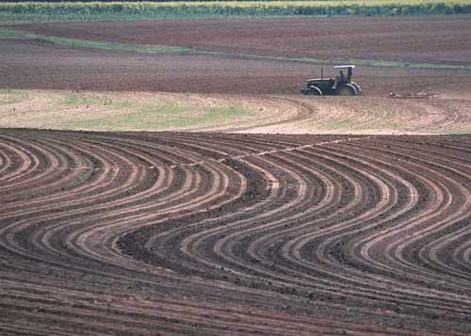
Contour Plowing: fields are plowed along the contours of the land to help reduce soil erosion.

Slide 15
No-till Farming
No-till farming (sometimes called zero tillage) is a way of growing crops from year to year without disturbing the soil through tillage.
No-till is an emergent agricultural technique which can increase the amount of water in the soil and decrease erosion. It may also increase the amount and variety of life in and on the soil but may require increased herbicide usage.

Slide 16
Global trend in Agriculture
Intensive agriculture especially in industrialised countries has contributed to environmental problems such as pollution of surface and groundwater with nitrates and pesticides, global warming, reductions in biodiversity and soil degradation, and virtual monocultures have spread over entire regions.
Organic farming on the other hand, offers a potentially more sustainable form of production. Organic farming is practiced in approximately 100 countries of the world and the area is increasing. Trade with organic products all over the world is a growing reality with the major markets being Europe and North America.

Slide 17
Bangladesh Agriculture at a Glance
Total area | : | 14.845million hectare
Forest | : | 2.599 million hectare
Cultivable land | : | 8.44 million hectare
Current fellow | : | 0.469 million hectare
Single cropped area | : | 2.851 million hectare
Double cropped area | : | 3.984 million hectare
Triple cropped area | : | 0.974 million hectare

Slide 18
Bangladesh Agriculture at a Glance…………..contd
Net cropped area | : | 7.809 million ha
Total cropped area | : | 13.742 million ha
Contribution of agrl sector to GDP | : | 23.50%
Contribution of crop sector to GDP | : | 13.44%
Manpower in agriculture | : | 48%

Slide 19
Characteristics of Bangladesh Agriculture
Cropping intensity 179%
Irrigated land 56%
Surface water:21% groundwater:79%
Land-man ratio: 0.06 ha
Mainly subsistence farming
Inadequate agro-processing
Non-mechanized farming
Fragmented land/plots
Dependence largely on nature

Slide 20
Some challenges
Rapid shrinkage of agricultural land @1% p.a.
Population growth @1.292% p.a.
Climate change and variations
Rapid urbanization growth @12% p.a.
Technology generation (needs expertise, time and money)
Technology dissemination (needs expertise,
time, logistics support)
Alternative livelihoods/rehabilitation program

Slide 21
Prospects of Agriculture
Modern technological knowledge is available for reducing yield gaps
Scope for expanding hybrid technology exists
Prospects for adoption of advanced technology in agriculture are bright
Potentials for proper utilization of hilly/haor/coastal areas including agro-ecologically disadvantaged regions exist

Slide 22
Prospects of Agriculture:…..contd
Export potentials exist for high-value crops
Scope for crop diversification, intensification and value addition to agricultural produces
Agriculture sector has capacity to absorb labor force and to generate income.

Slide 23
Climate Change matters for agriculture?
Heavily depends on natural rainfall, weather & temperature, water level, soil condition etc.
Uncontrolled farming env. (flooding, drought, etc)
Rice based agriculture greatly depends availability of fresh surface/rain and ground water
Seasonal farming
Lack of stress tolerant varieties

Slide 24
Combating Climate Change Impact
Adaptation
Stress (flood, drought, submergence, salinity, heat, cold..) tolerant varieties
Short duration crops
Innovative farming practices
Floating cultivation method
Crop diversification
Changing/shifting cropping pattern
Alternative wetting and drying irrigation methods

Slide 25
Continued…
Mitigation
Coastal green belt
Embankment/Dam
Tidal River Management
Early warning and weather forecasting
Crop insurance
Saline tolerant rice

Slide 26
Integrated Pest Management Techniques

Slide 27
Pesticide Consumption (MT)
Pesticide consumption has more than doubled in the past decade
Source: Department of Plant Protection Wing, Bangladesh

Slide 28
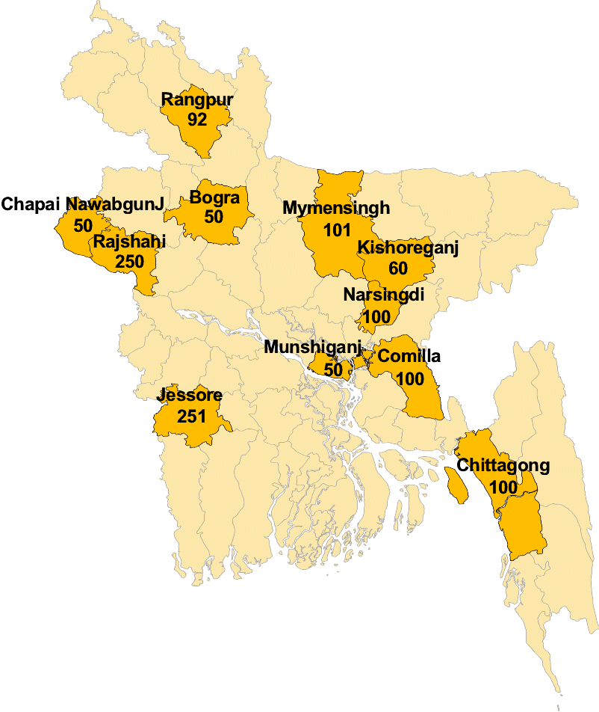
World Bank Research on Pesticides

Slide 29
Pesticide Applications Reported by Survey Respondents
Number of pesticide applications by WHO classification
Classification
Frequency
Per
cent
Extremely hazardous
778
19.12
Moderately hazardous
2383
58.58
Slightly hazardous
305
7.50
Unclassified
602
14.80
Total
4068
100.00
Note: Based on 51 active ingredients and 161 formulations (commercial names)
Persistent Organic Pollutants (POPs):
The survey cited 18 applications of Endrin and 40 applications of Heptachlor were cited in the survey.
DDT is still sold in the retail markets.

Slide 30
Specific Health Effects found in the Survey
Among the most perceptible health problems encountered in the survey, eye effects, neurological effects (headache, dizziness), dermal effects and gastrointestinal tract effects (vomiting) were the most common.
Right after application of pesticides:
27% of the respondents reported irritation in the eyes
33% reported headache/ and dizziness
14% reported skin irritation
9% reported vomiting

Slide 31
Conclusion
Agriculture is the determining factor for food security as well as pro-poor development of Bangladesh economy.
The Problems of agriculture are multifaceted. So the ways of addressing the challenges should be comprehensive, global and participatory for sustainable agricultural development of Bangladesh.

Slide 32
Population Pressure on Land and Development
The country has reached a point of maximum utilization in terms of potential arable land and intensity of cropping and the only option left is to improve the agricultural production through modernization of agriculture;
a. Wheat Production:
Pakistan = 2.1 metric tons per hectare
Germany = 6.9 metric tons per hectare
b. Corn Production:
India = 1.6 metric tons per hectare
U.S. = 7.1 metric tons per hectare
But it is also true that without improving the human capital such a technological transformation may not be feasible.

